Slide 1
Walmart Sales Prediction
Rupali Shah

Slide 2
Table of Contents
Overview
Data acquisition
Hypotheses generation
Exploratory data analysis
Feature Engineering
Predictive models
Results
Future Work

Slide 3
Overview
Analyze sales of products at Walmart stores
Build models to predict features that can help increase sales
Statistical methods used to create models:
Linear Regression
Lasso Regression
Random Forest

Slide 4
Data Acquisition
Historical sales data for Walmart outlets in different cities for the year 2013
Dataset - 8523 records, 13 features, and 1 target variable
Data source - Kaggle
https://www.kaggle.com/anshg98/walmart-sales

Slide 5
Hypotheses Generation
Outlet type
Outlet location
Product type
Product price
Product visibility
Customer loyalty

Slide 6
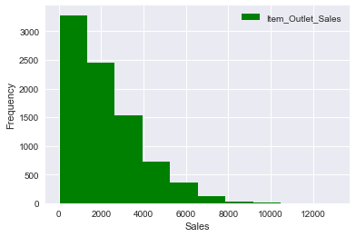
Exploratory Data Analysis Overall Sales

Slide 7
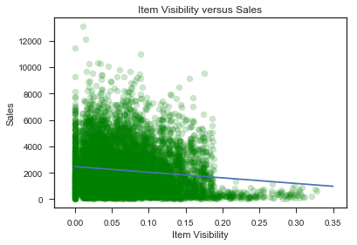
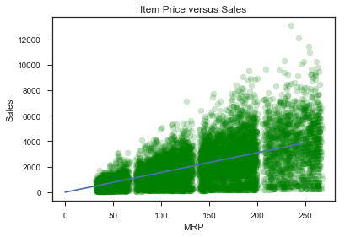
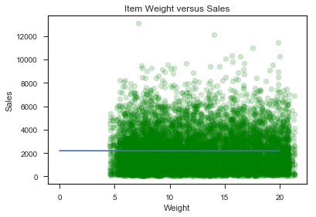
Exploratory Data Analysis Item Visibility, Weight and MRP

Slide 8
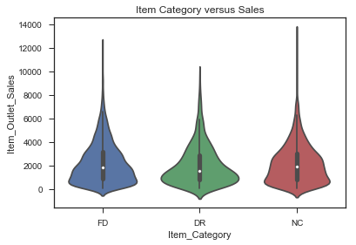
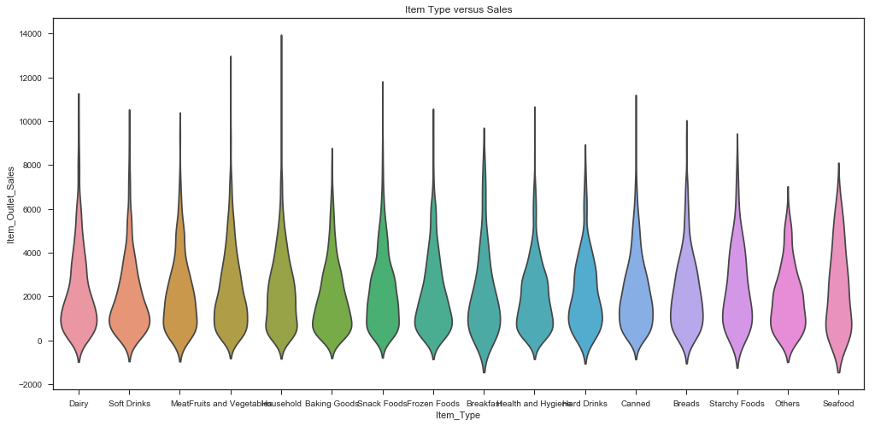
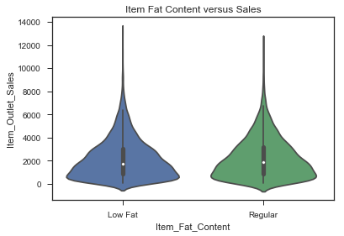
Exploratory Data Analysis Distribution of Sales across all products

Slide 9
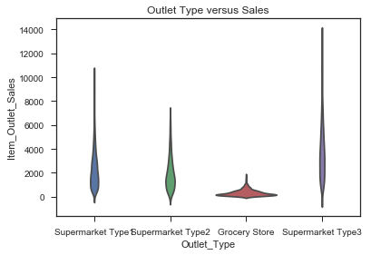
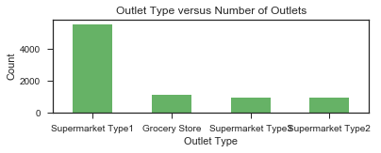
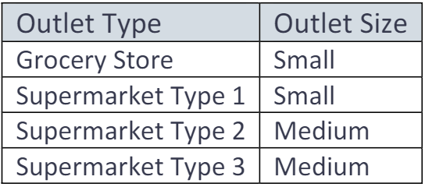
Exploratory Data Analysis Type and Size of Outlets

Slide 10
Feature Engineering
Item Type is categorized into three broad categories – Food, Drink, and Non-consumable.
Missing values of Item Weight are imputed based on weight of other similar items.
Missing values of Outlet Size are filled based on the Outlet Type.
Outlet Age is computed and added as new column.
Columns that are grouped into new features are deleted.

Slide 11
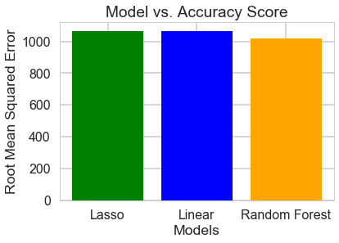
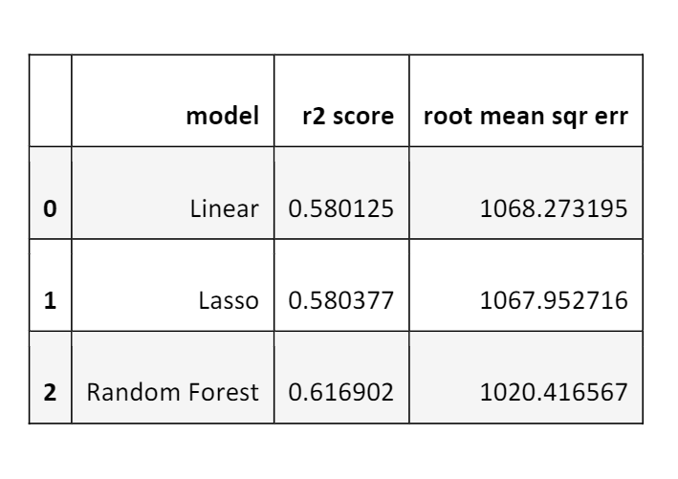
Predictive Models

Slide 12
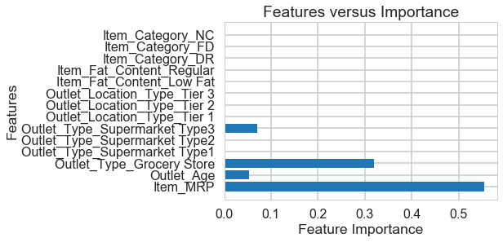
Feature Importance

Slide 13
Results
MRP is the most important predictor of sales followed by Supermarket Type and Outlet Age
Older stores have customer loyalty
Location of the outlets does not impact sales
Grocery Stores and Supermarkets that carry a larger variety of products will help increase future sales

Slide 14
Future work
Other models such as XGBoost can be tested.
Models can be tested with a different subset of features.
Outliers can be removed to reduce skewness and to improve model performance.

